Slide 1

SunTrac Design Team
Presentation 3
06 November, 2019 - Northern Arizona University
Kadeja Alhossaini
Nathan Firor
Edwin Smith
Ethan Vieane

Slide 2
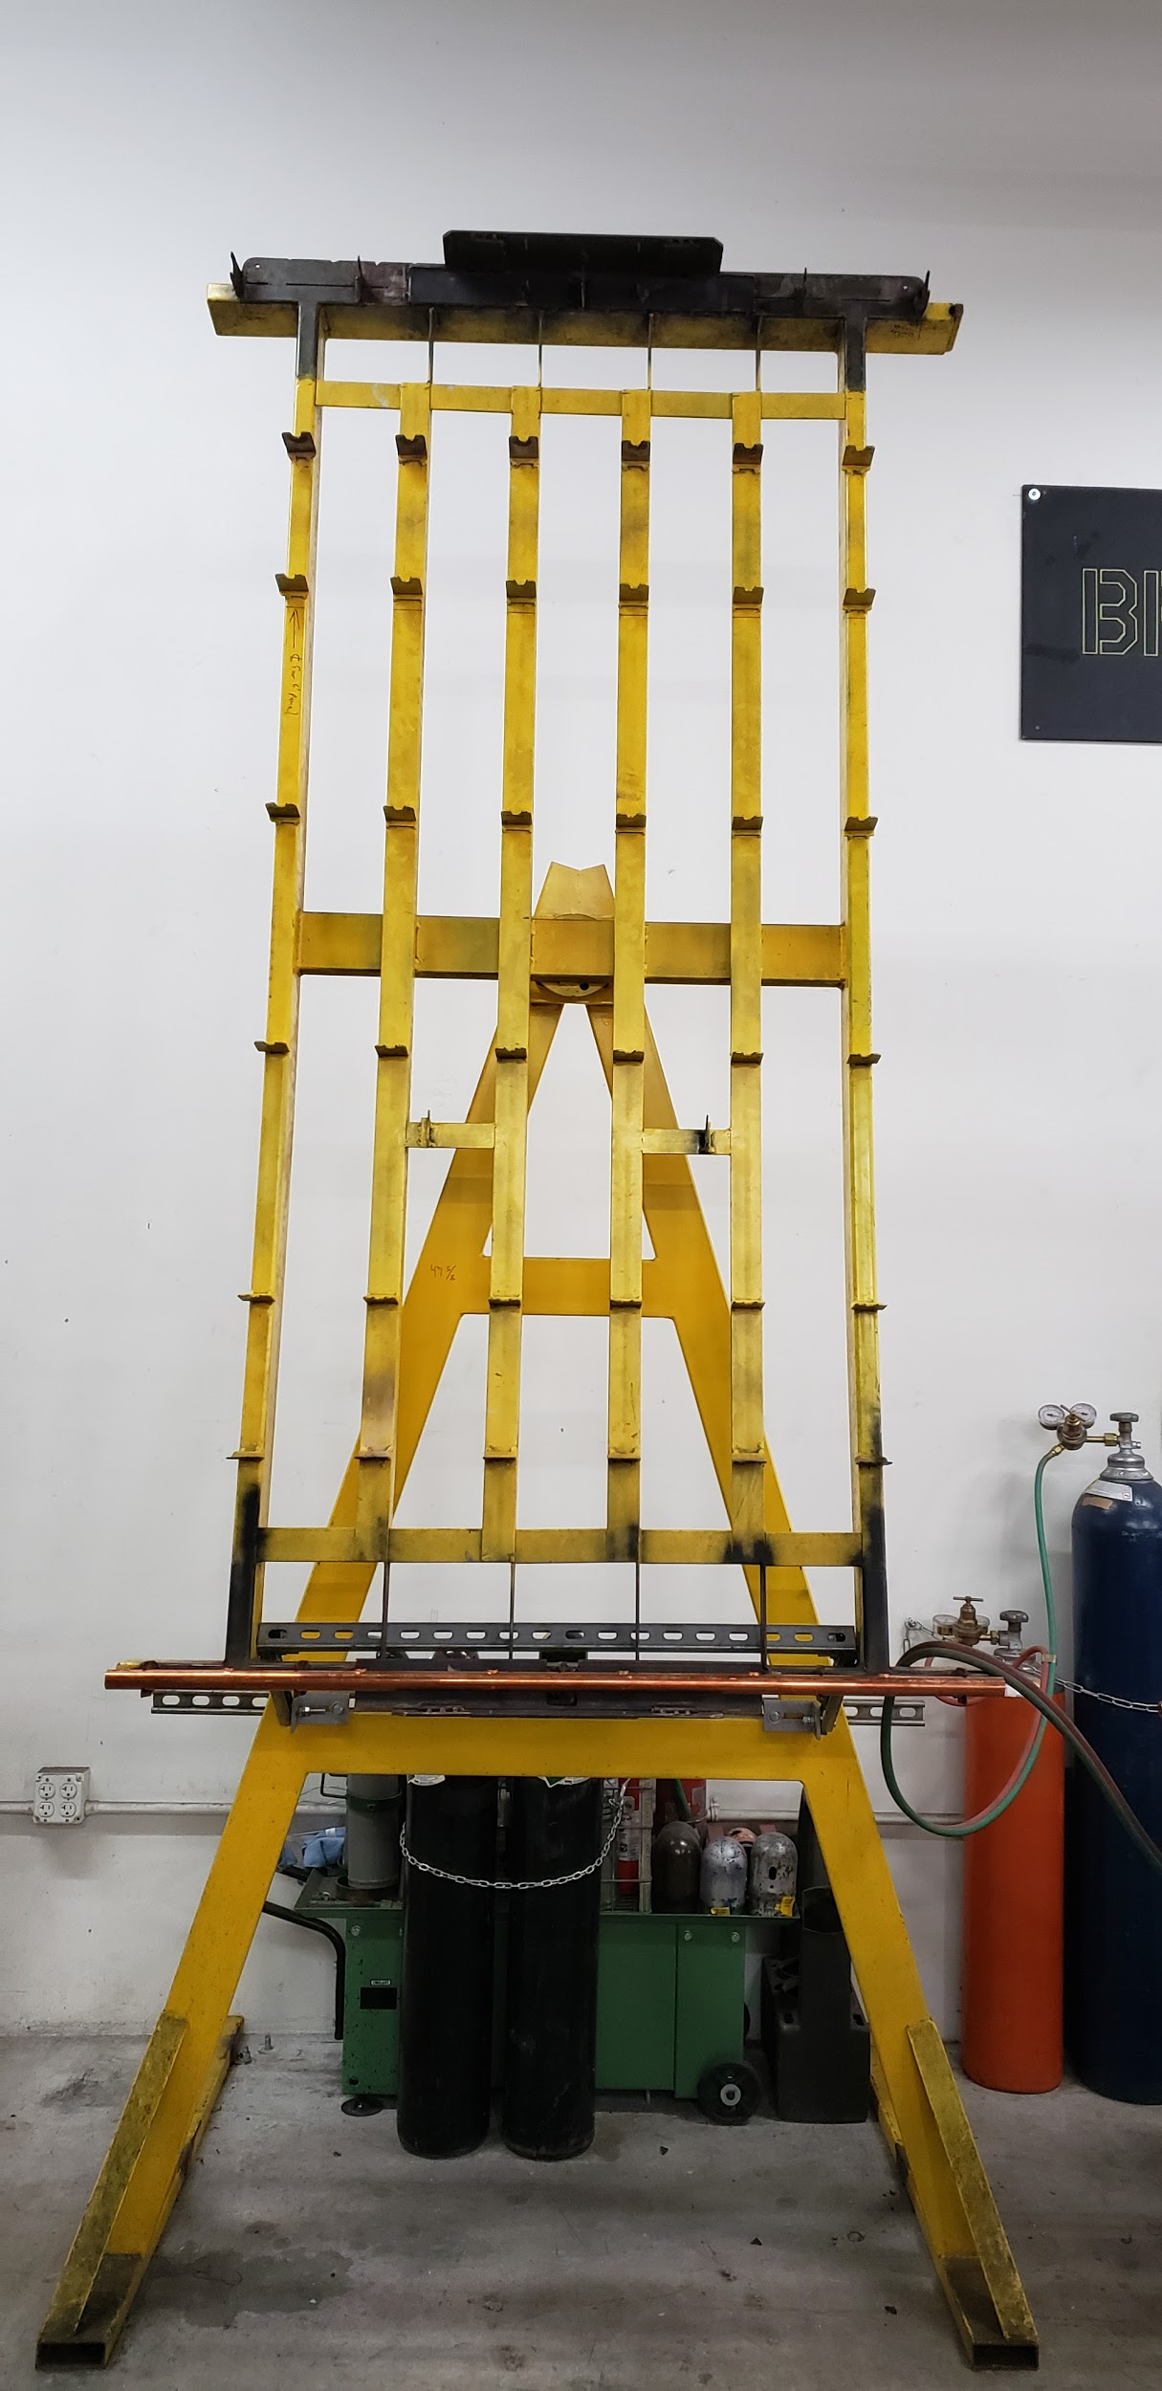
Project Description
The task is to design a braze welding jig compatible with assembling
SunTrac’s 4’, 6’ and 8’ solar thermal pipe manifolds.
As a team we are to...
Create detailed drawings
Provide a 1:4 scaled model
Build one full scale braze welding jig
Ensure design is easy to manufacture
SunTrac will take our drawings and build multiple braze welding jigs over the next
three years as they expand to a bigger facility.
Figure 1: Current 8’ Braze Welding Jig
Firor 1

Slide 3
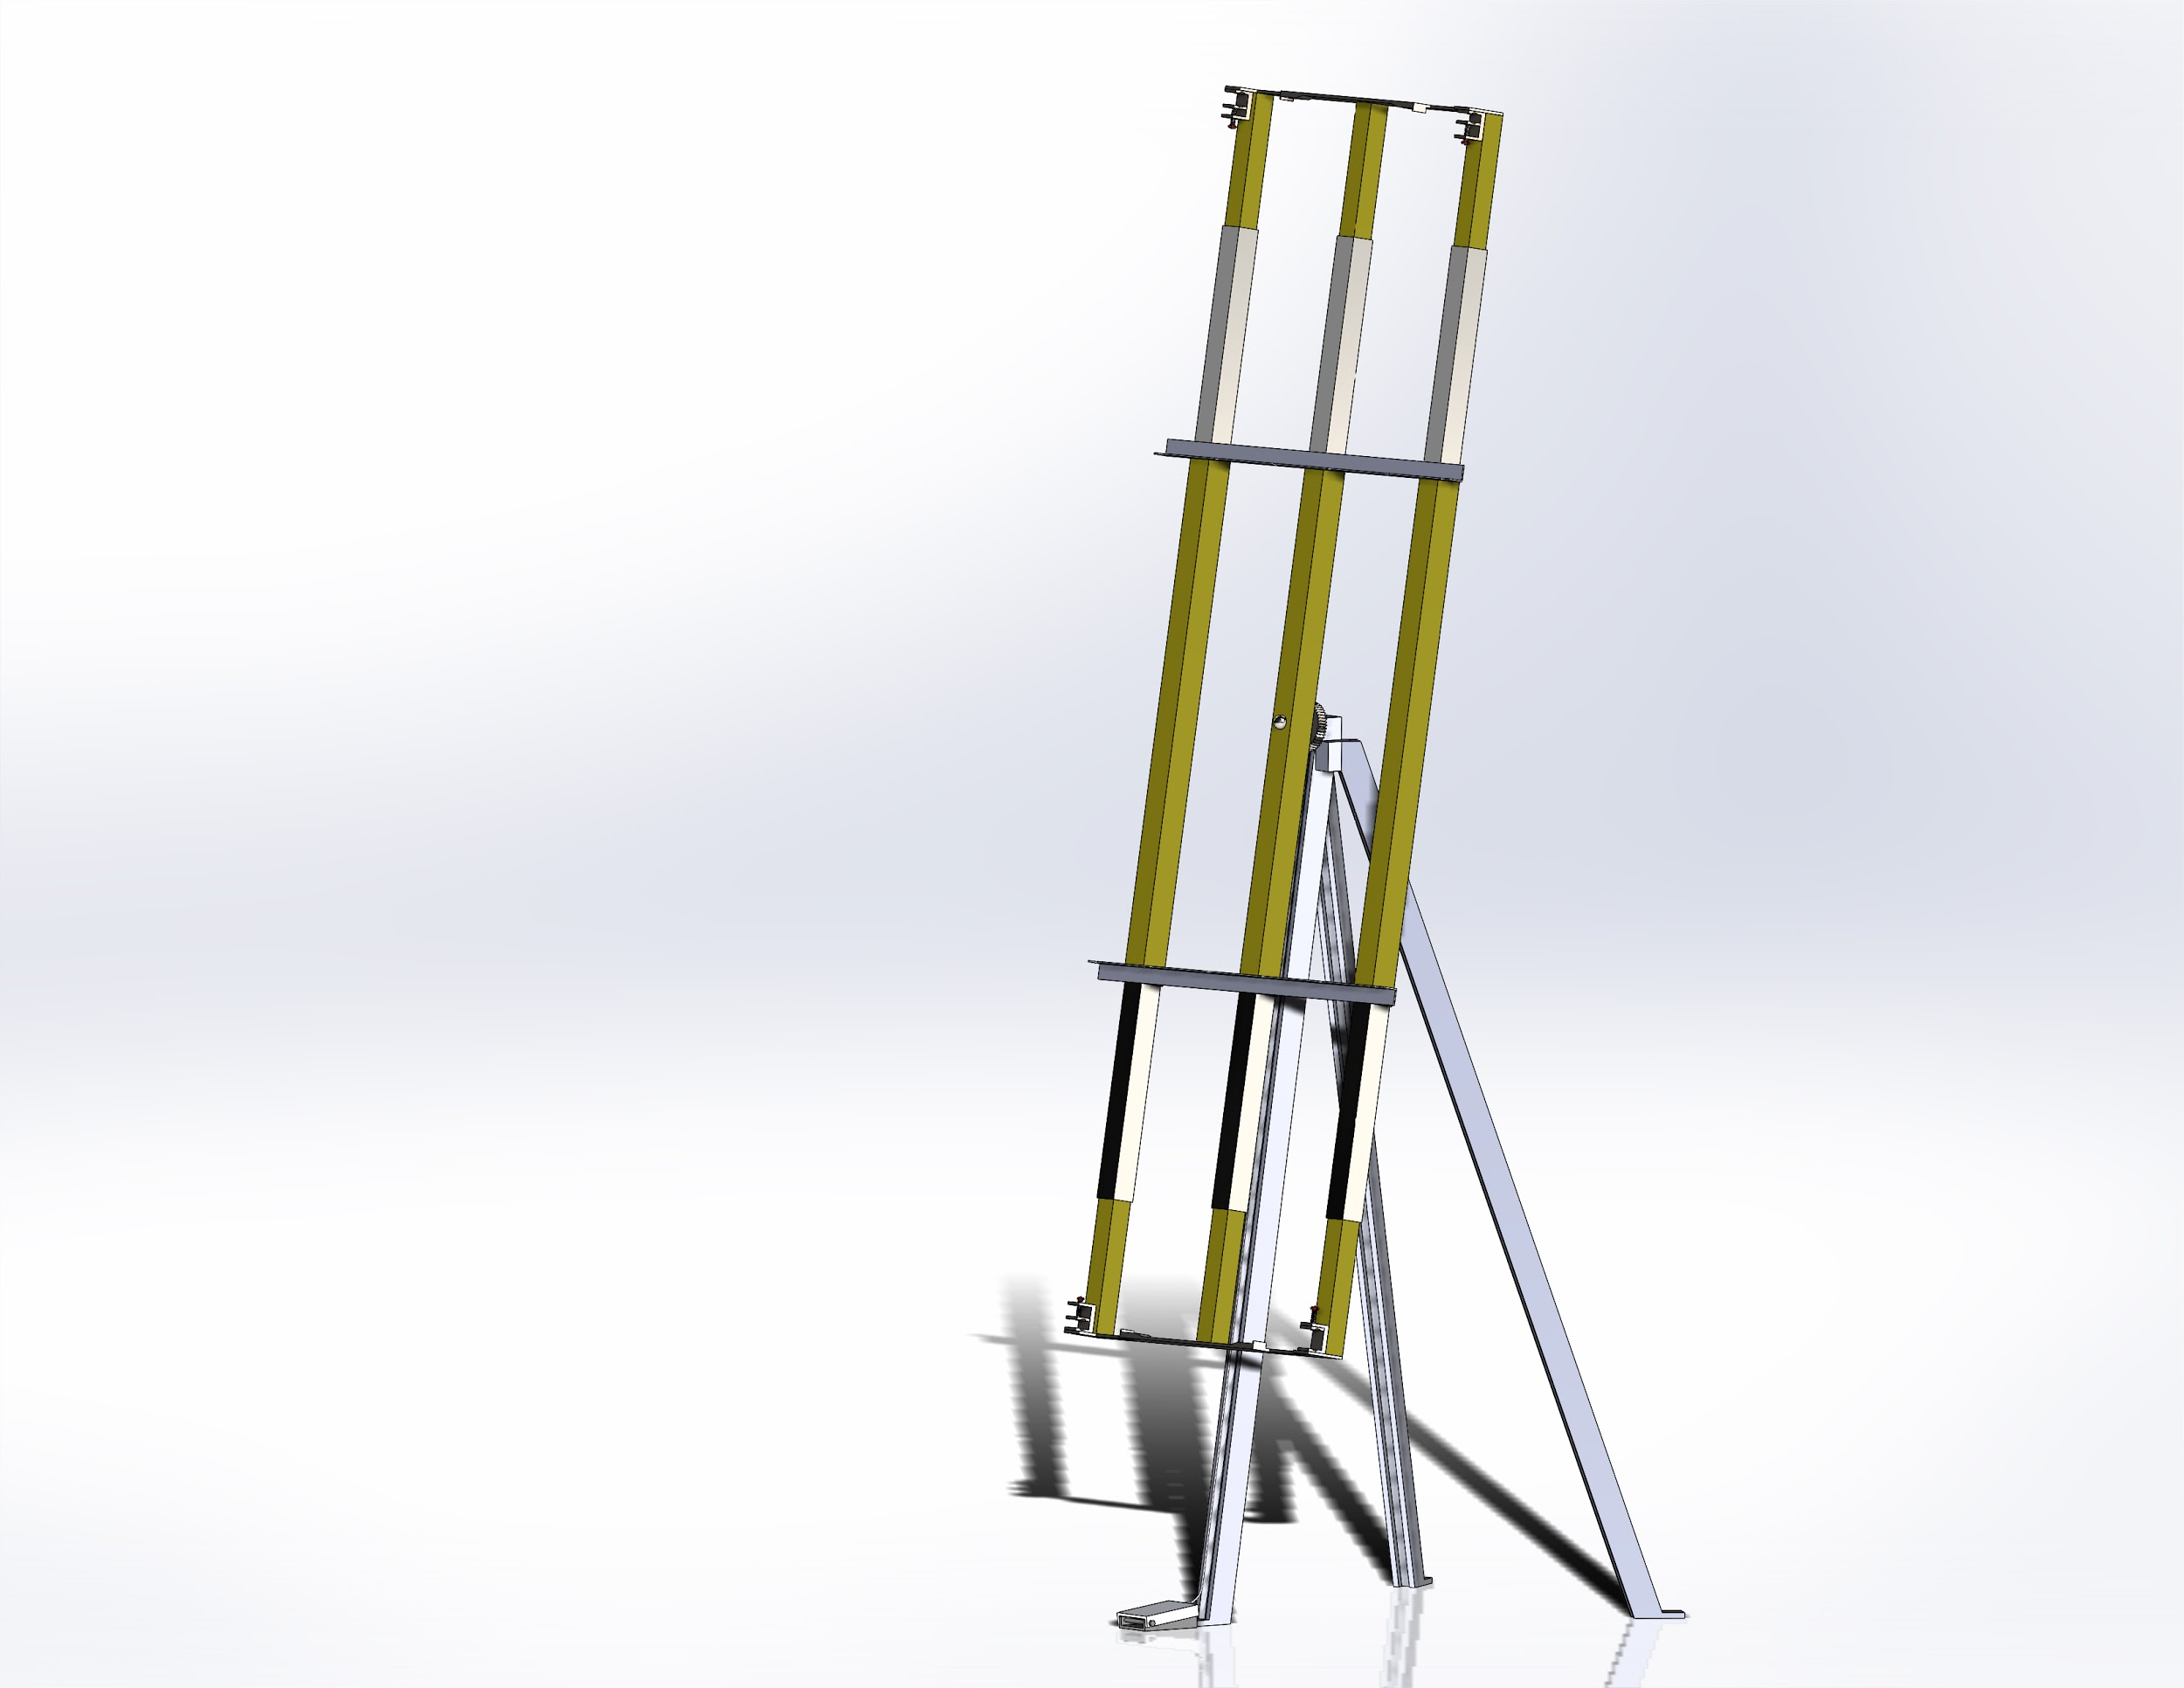
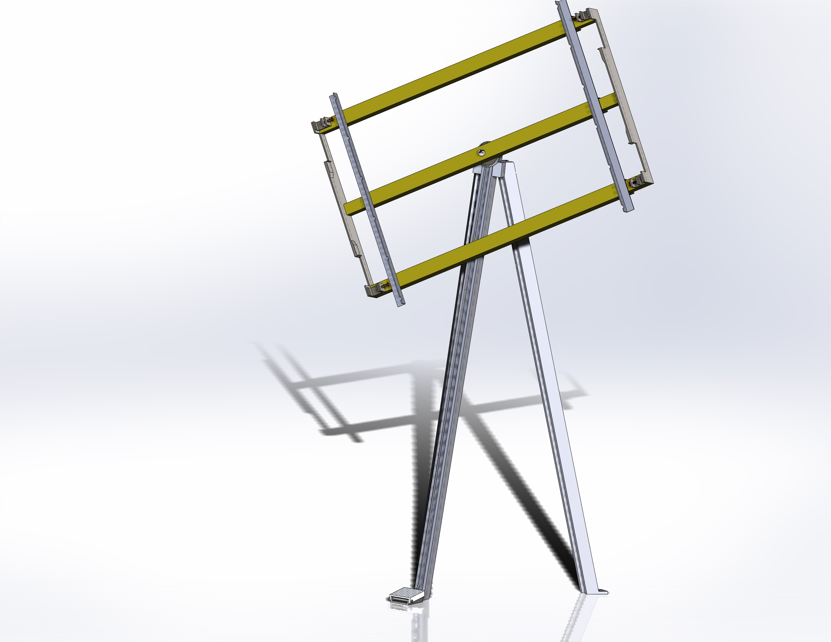
CAD Assembly
Height: 10.85 ft
Footprint: 5.35 ft^2
Gear
Aligning Standoffs
Collapsible Square Tubes
Power Screws
Cable
Spring Supported Foot Pedal
Figure 3: Collapsed, Tilted 4 Foot Jig
Figure 2: 8 Foot Configured CAD Model
Firor 3

Slide 4
Design Requirements
The customer requirements are:
Safe to Operate (5)
Cost within budget (5)
Can fit a 4’, 6’, and 8’ copper manifold (5)
Standard or simple machined parts (4)
Fit within a 5’x5’ square (3)
Allow easy access to all copper joints (4)
Jig can rotate and lock at various angles (3)
Durable and Robust design (4)
Reliable design (4)
Rated from 1-5, 5 being most important.
Alhossaini 4

Slide 5
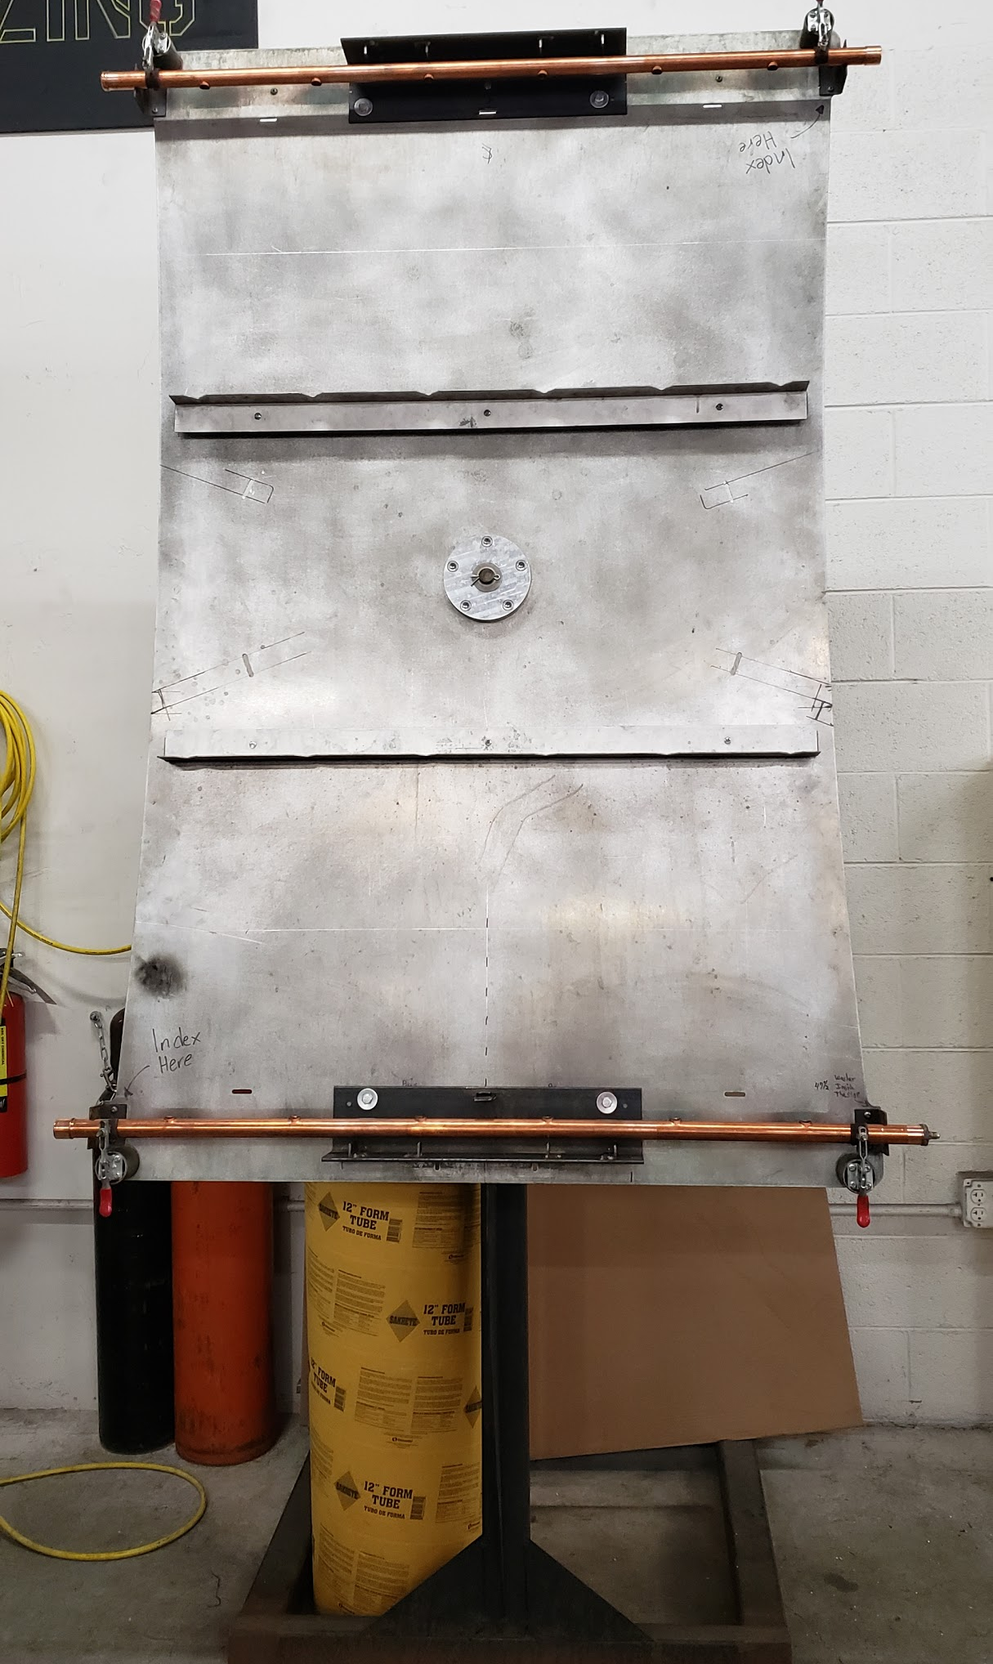
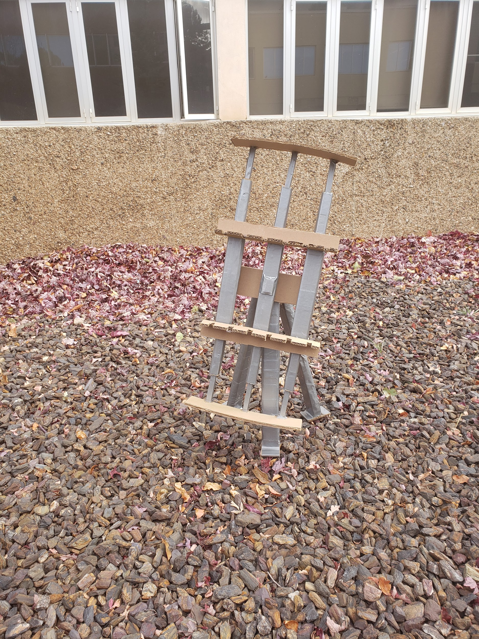
Design Requirements
CR: Allow easy access to all copper joints
CR: Can fit a 4’, 6’, and 8’ copper manifold
ER: Versatile (handles a number of compatible product variations)
Figure 4: Existing 6’ Jig
Figure 5: Prototype
Alhossaini 5

Slide 6
Design Requirements
Computational analysis to prove that CRs and ERs have been met:
Cost Analysis [CR: Cost within budget, ER: Cost (dollars) < $1500]
The cost limit is $1,500 and the total estimate is $1,401.05.
Footprint Analysis [CR: Fit within a 5’x5’ square, ER: Footprint (meters^2) < 25 m^2]
The jig is within a 3.11’x 3.5’ square, thus the area is 10.885 m^2.
Teeth on Gear Analysis [CR: Jig can rotate and lock at various angles, ER: Adaptable (Number of locking positions) > 6 positions, Degree of Rotation (Radians) (2𝜫)]
The gear has more than 10 teeth which means that there are more than 10 locking positions and it can
rotate 360° or 2𝜫 radians.
Parts Analysis [CR: Standard or simple machined parts]
The bill of materials is made up of parts that can be bought from McMaster-Carr and/or machinable parts.
Alhossaini 6

Slide 7
Design Requirements
The analytical analysis to prove the design will be successful:
Moment of Inertia on square vs cylindrical rods [CR: Durable and Robust design]
The moment of inertia on the square rods is greater therefore it has less chance of angular deflection when subjected to the same force.
I_square = 1/12*((b*h^3)o - (b*h^3)i) = 1/12*((3 in^4 - 2 in^4)o = 5.42 in^4
I_cylinder = π/4(ro^4 - ri^4) = π/4(3 in^4 - 2 in^4) = 3.19 in^4
Center of mass Analysis [CR: Safe to Operate/Reliable design, ER: Center of mass within the boundary (legs of the jig) < 4’’from each side]
Through SolidWorks the center of mass is 46.77 inches from the ground, thus being within the safe limit.
Force to yield gear lock [CR: Durable and Robust design, ER: Force to Rotate (Newtons) <130 lbf]
The force required to lock the gear in position does not plastically deform the gear teeth.
In our calculation in Appendix D the force applied on a 20 teeth gear is 108.7 lbf, therefore it will not deform.
Alhossaini 7

Slide 8
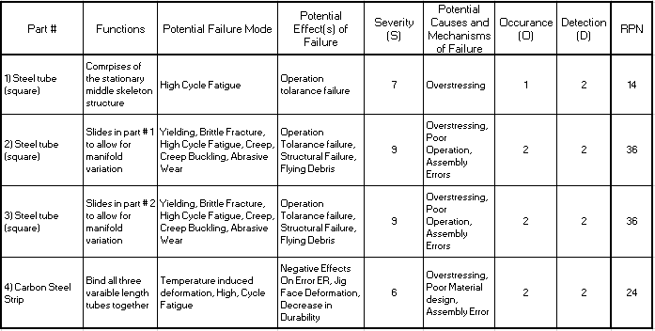
FMEA
Smith 8

Slide 9
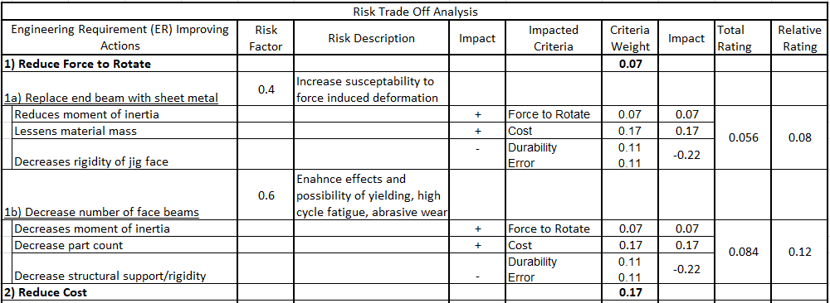
Risk Trade-Off Analysis - Method
Smith 9

Slide 10
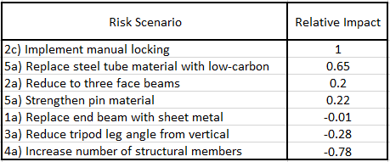
Risk Trade-Off Analysis - Results
Smith 10

Slide 11
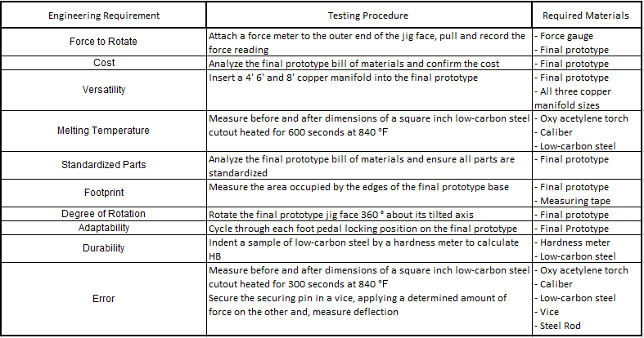
Testing Procedures
Smith 11
Notes:
TP1: Error, Versatility, Degree of Rotation
TP2: Melting Temperature, Durability
TP3: Cost, Standard Parts
TP4: Force to Rotate, Adaptability
TP5: Footprint

Slide 12
Testing Procedures - Requirements
Final prototype
4’, 6’, and 8’ copper manifold
Force gauge
Oxy acetylene torch
Caliper
Low-carbon steel sample
Measuring tape
Hardness meter
Vice
Steel sample rod
Smith 12

Slide 13
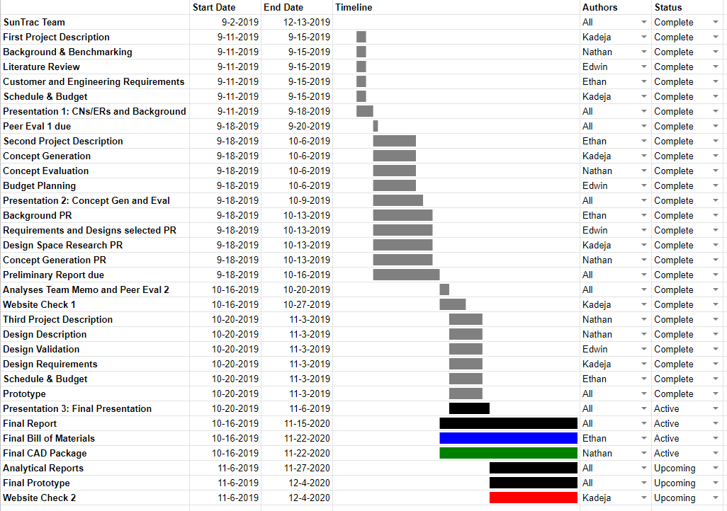
Schedule
Vieane 13

Slide 14
Budget Planning - Total Expenses
Final design: $815.59
Prototyping (¼ High Fidelity Scale Model): $200
Travel: $100
Spare parts (15% total cost): $122.34
Broken parts (20% total cost): $163.12
Total estimated: $1,401.05
Vieane 14

Slide 15
Thank You For Listening
Any Questions?

Slide 16
References
[1] Startseite, Z. (2019). Gallery Method - Methodos @ TU Braunschweig. [online] Methodos.ik.ing.tu-bs.de. Available at:
https://methodos.ik.ing.tu-bs.de/methode/GalleryMethod.html [Accessed 7 Oct. 2019].
[2] “Carr,” McMaster. [Online]. Available: https://www.mcmaster.com/. [Accessed: 08-Oct-2019].

Slide 17
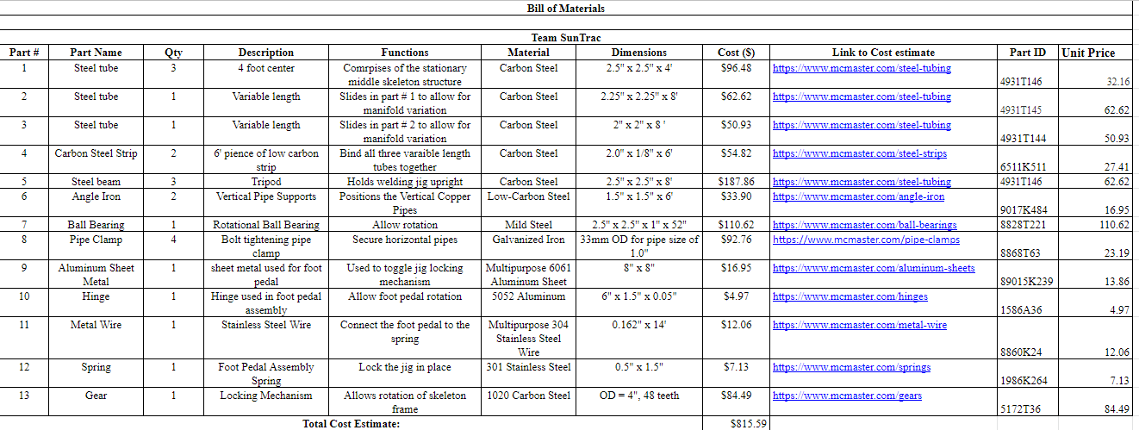
Appendix A: Bill of Materials
<Bill of Materials>

Slide 18
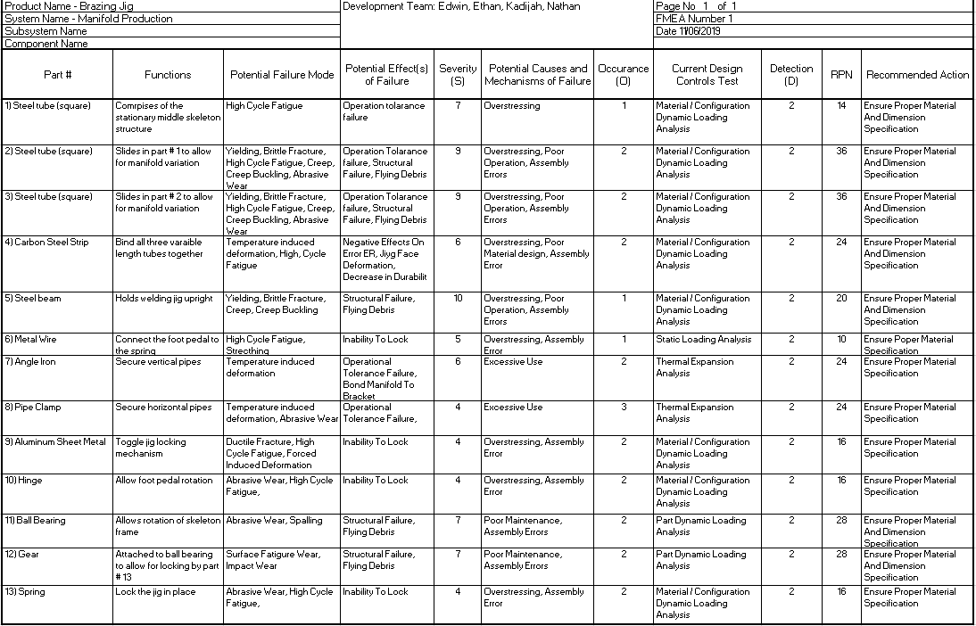
Appendix B: Full FMEA

Slide 19
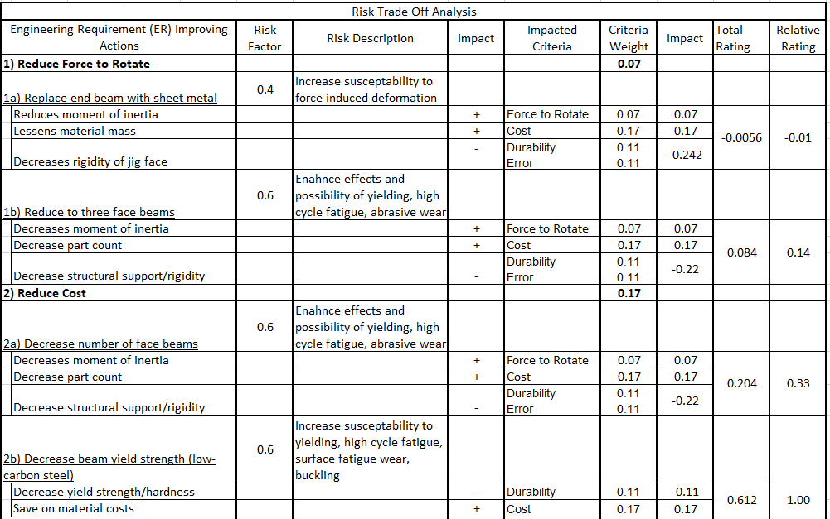
Appendix C: Risk Trade Off Analysis Pt. 1

Slide 20
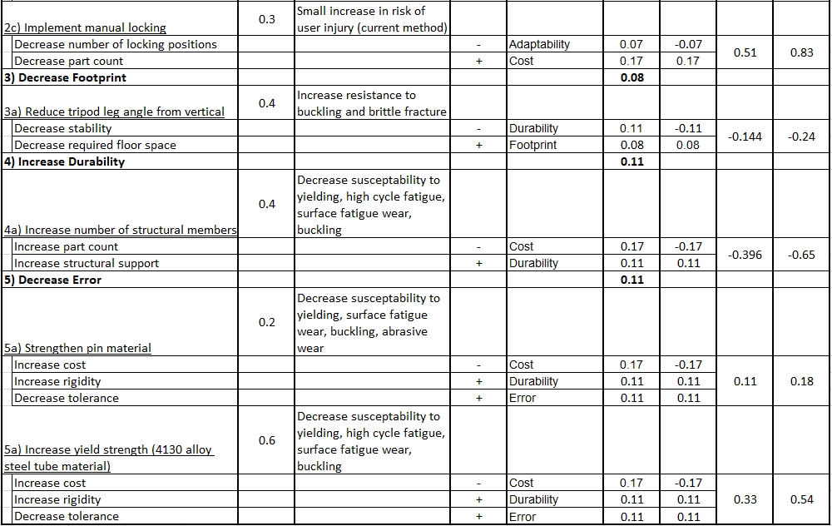
Appendix C: Risk Trade Off Analysis Pt. 2

Slide 21
Appendix D
Force to yield gear lock
P = TPI (Threads Per Inch)
n = number of teeth
t = half tooth thickness
P = n/d = 20teeth/2in = 10 TPI
t = 𝜋/(2*2*P) = 𝜋/(2*10TPI) = 0.03925 in
∑M = 0 = F*L - FR *Rgear ==> F*L - Ac*σy*sin(20) *Rgear
0 = F * 48 in - 0.03925 in (72,800 Psi)*sin(20) * 2 in
Solving for F gives F = 108.7 lbf

